Slide 1

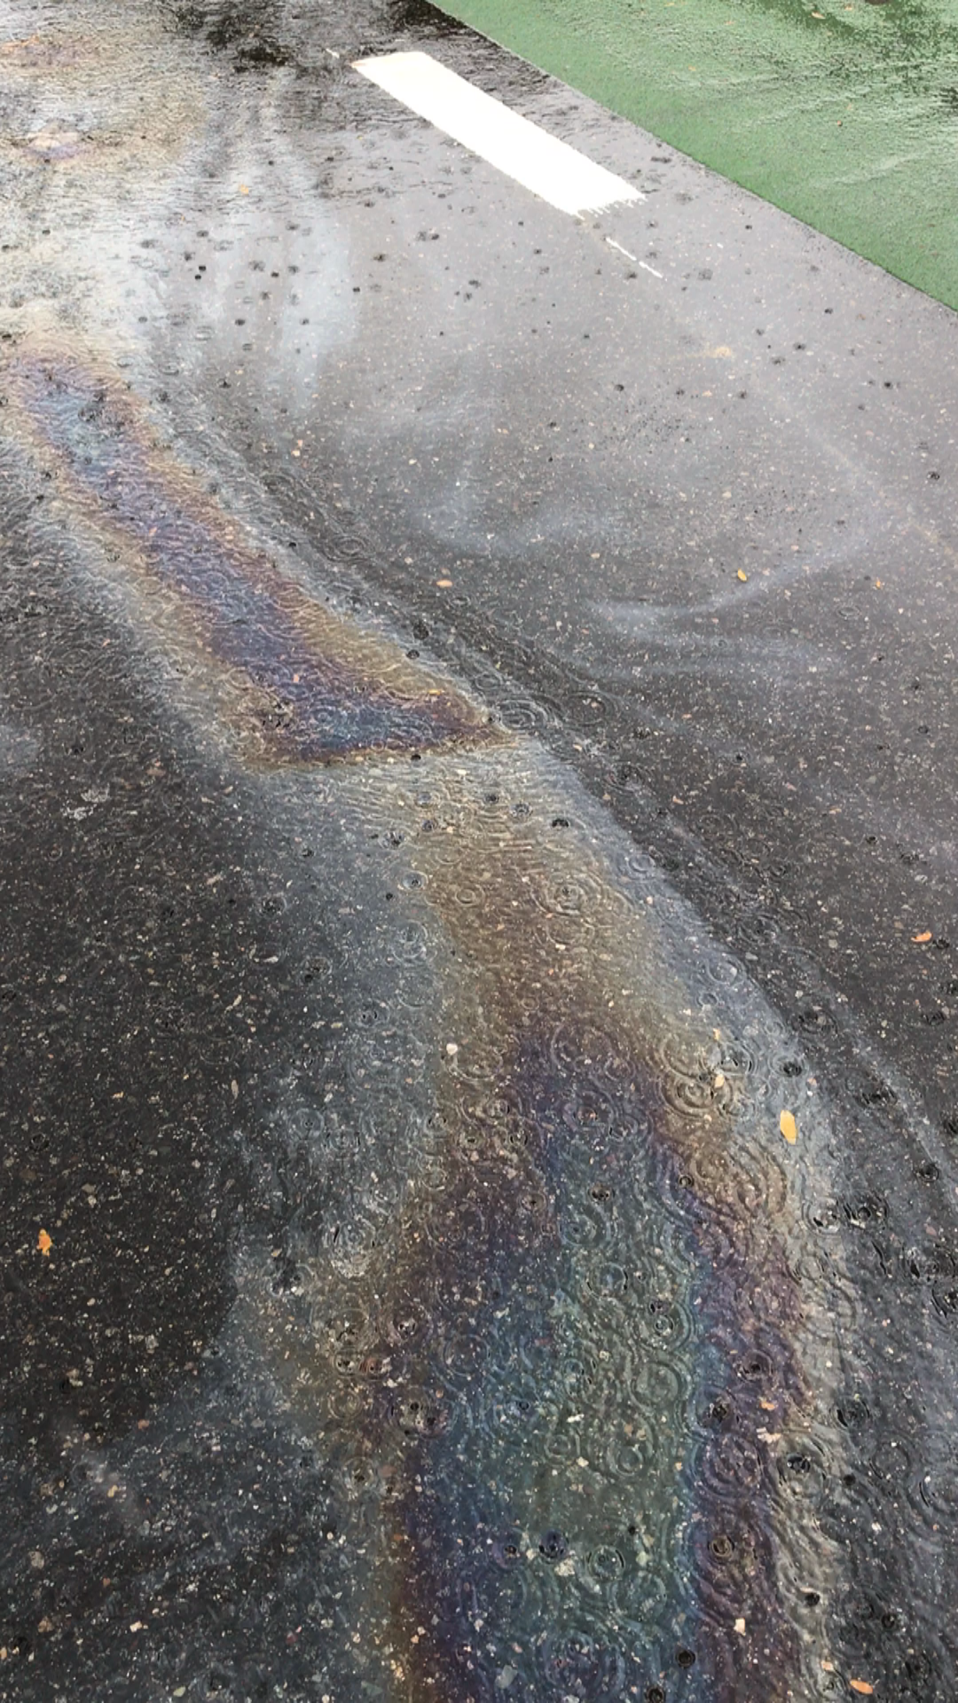
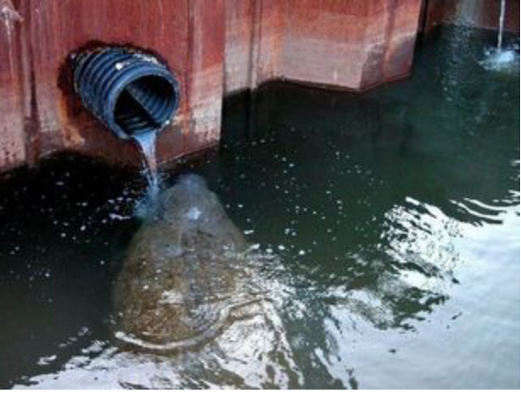
Scott Horsley
Water Resources Consultant

Slide 2
Weston & Sampson Phase 1 (2014)
Primarily country drainage with some outfalls (point sources)
Highway runoff from Route 6 into Pilgrim Lake (East Harbor)
Direct discharges to Pamet River
Stormwater infiltration is source of nutrients to groundwater
Stormwater N loading rate 13.5 lbs N/acre-year
  Wellfleet MEP 1.5 mg/liter and 37.8 inches/year = 12.8 lbs N/acre-year
12,013 lbs Nitrogen/year from impervious surfaces/stormwater
  Equivalent of 1155 Title 5 septics @ (4.73 kg/year per septic)

Slide 3
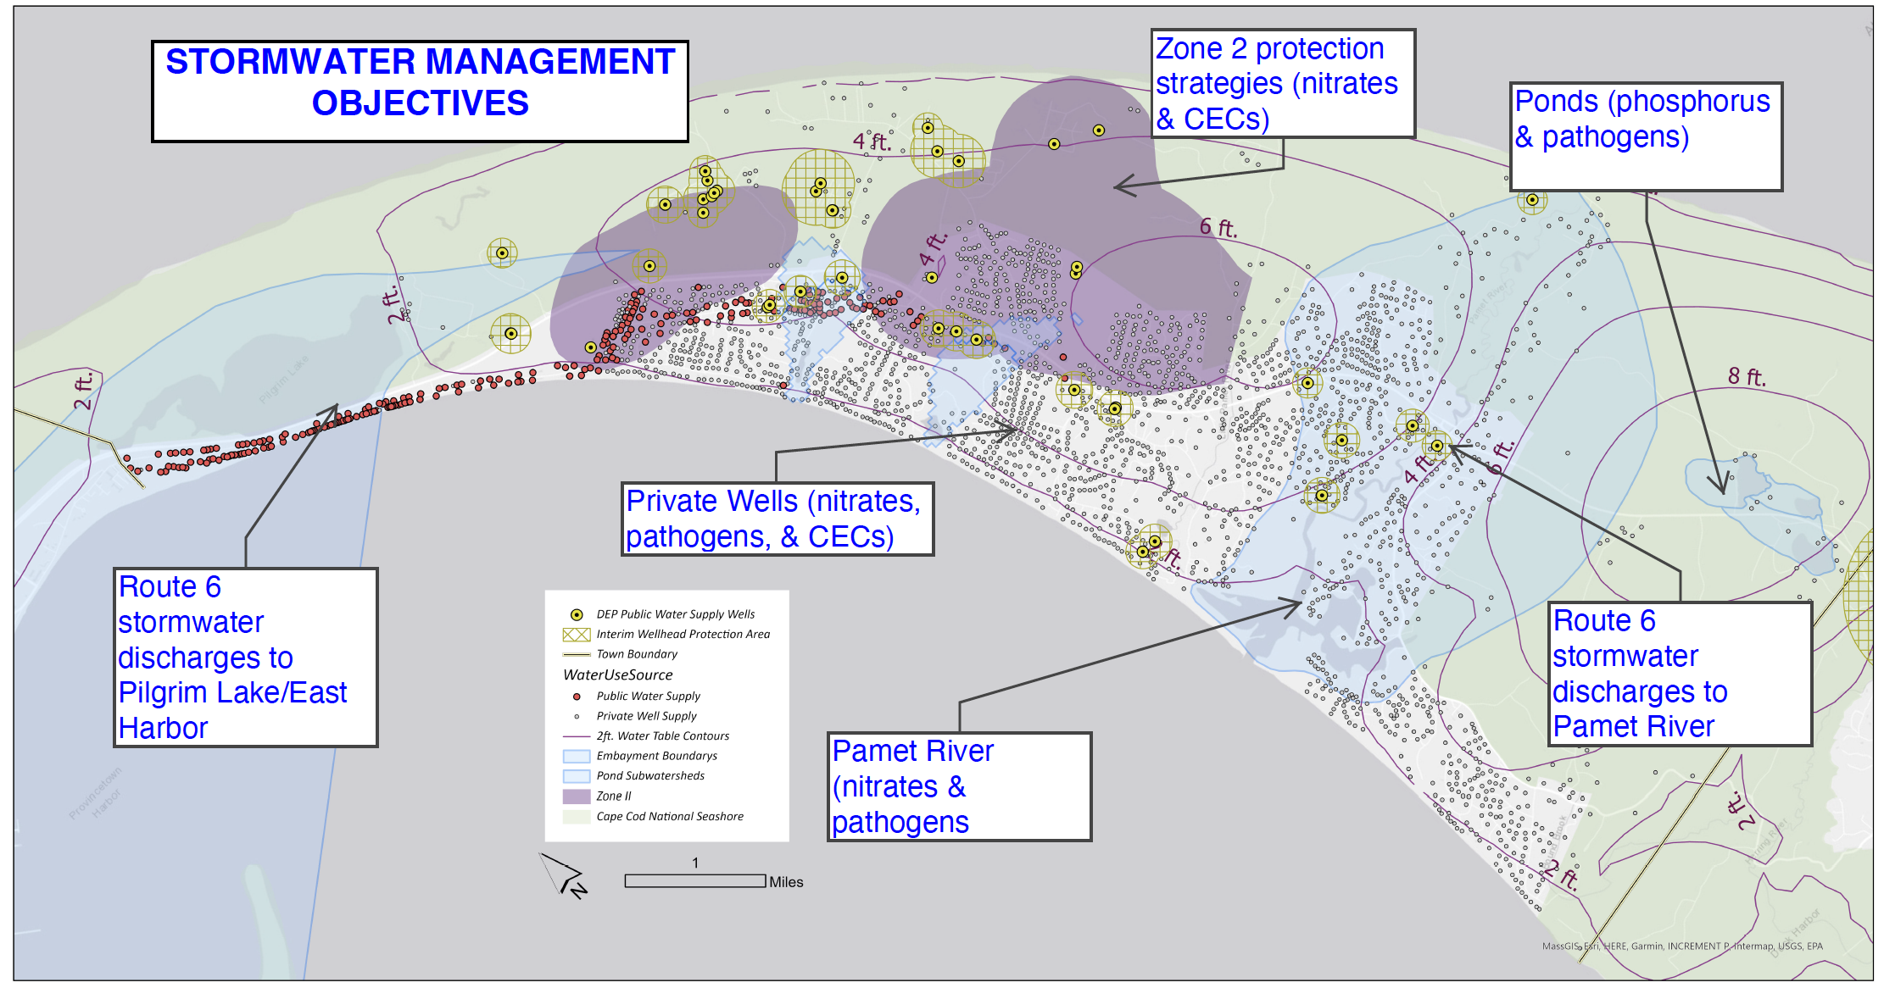

Slide 4
Summary of Stormwater Runoff Pollutant Effects
Sediment
Thermal Stress
Nutrients
Oxygen-Demanding Organics
Toxic Substances
Pathogens
Stream Discharge

Slide 5
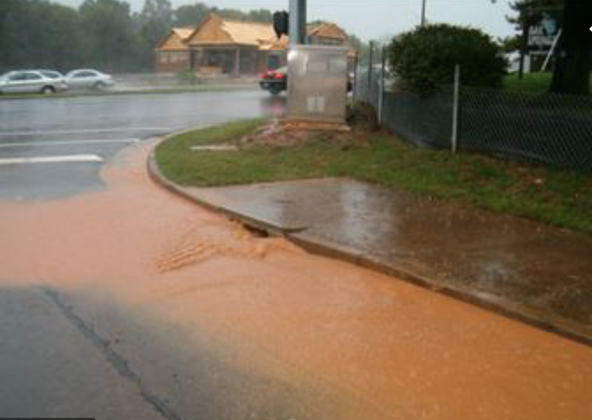
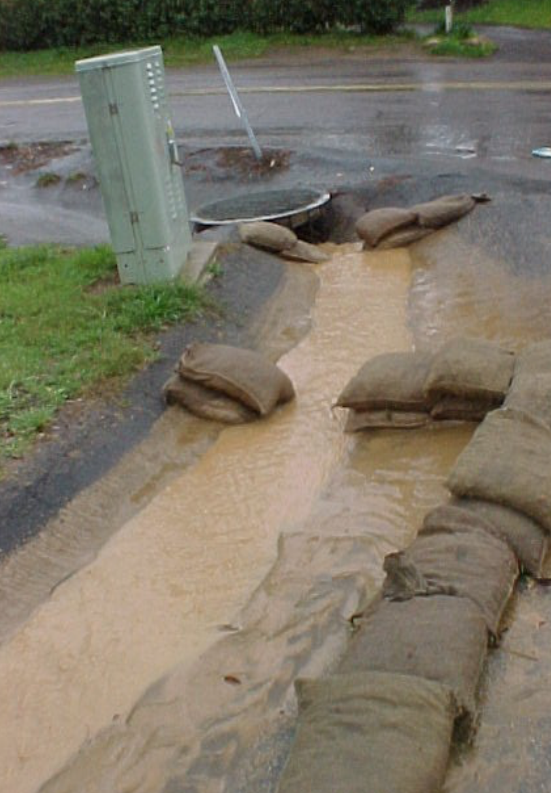
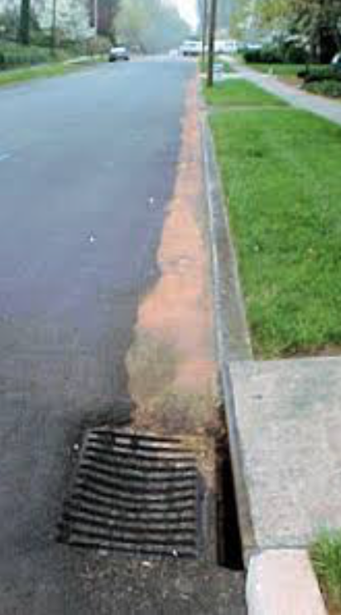
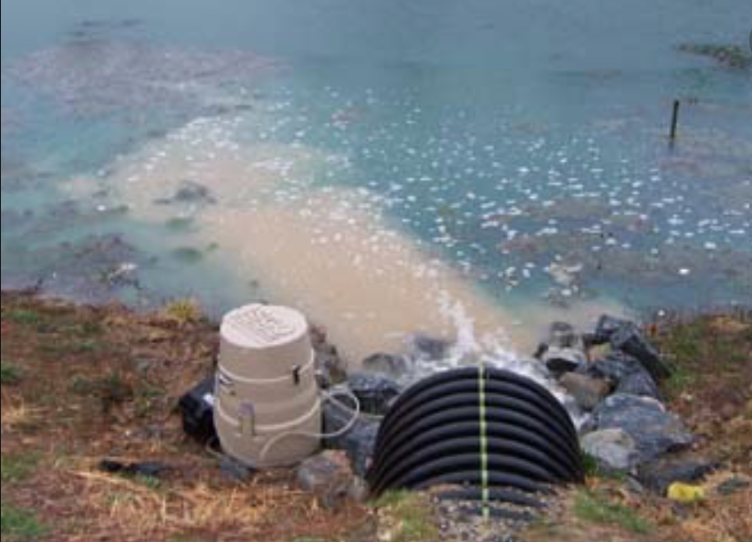
TSS = total suspended solids (particulates)

Slide 6
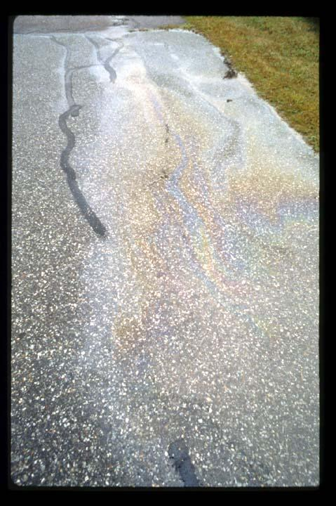

Slide 7
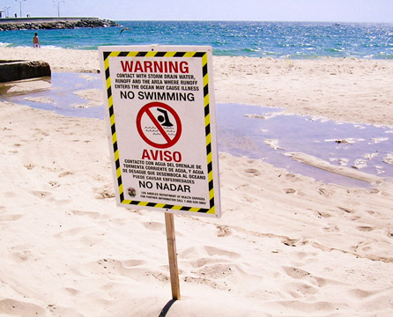
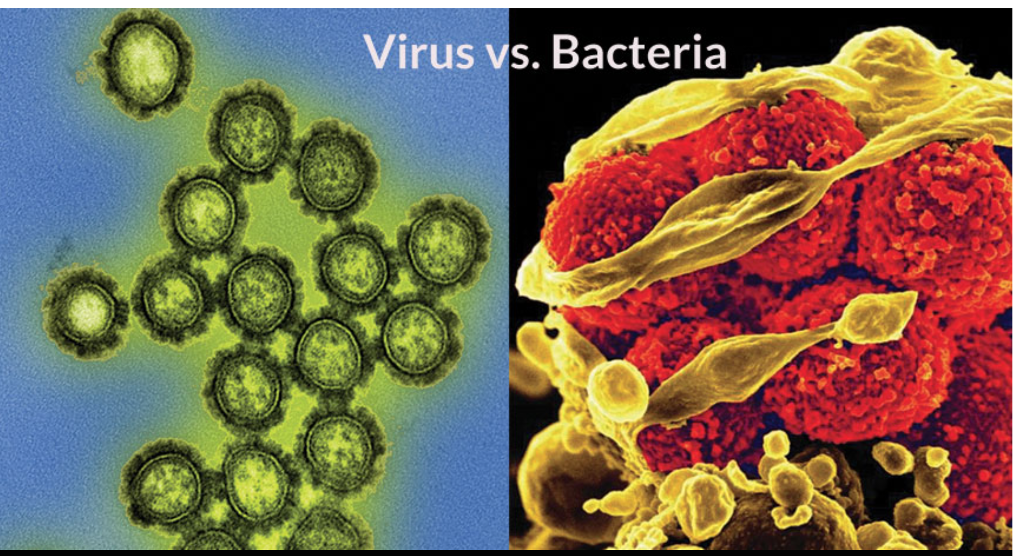
Pathogens close swimming beaches and shellfish areas

Slide 8
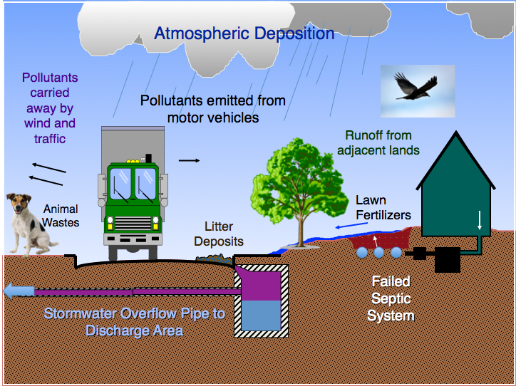

Slide 9
Failed Septic System
Water Body
Sidewalk
Catch Basins
Driveway

Slide 10
Bioretention Cell
Failed Septic System
Water Body
Sidewalk
Catch Basins
Flow
Splitter
Driveway

Slide 11

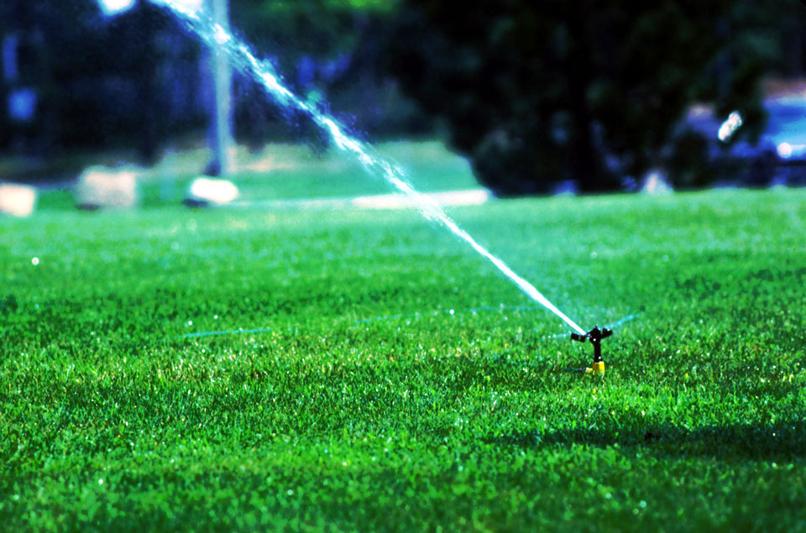
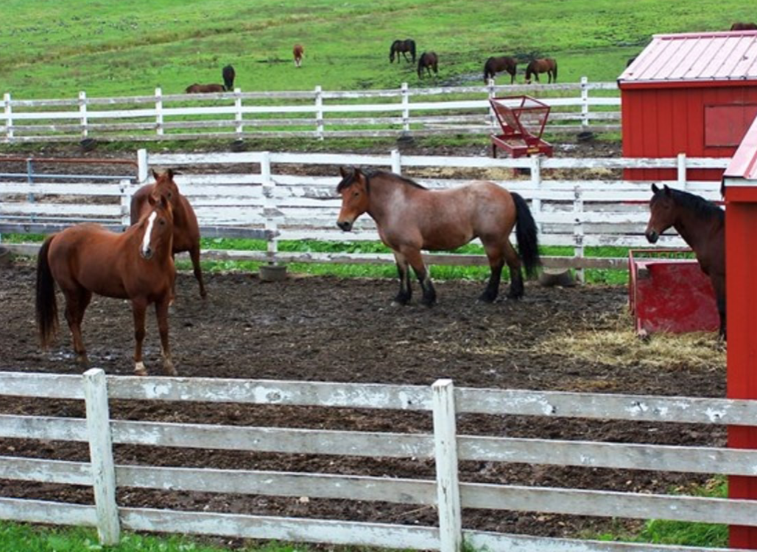
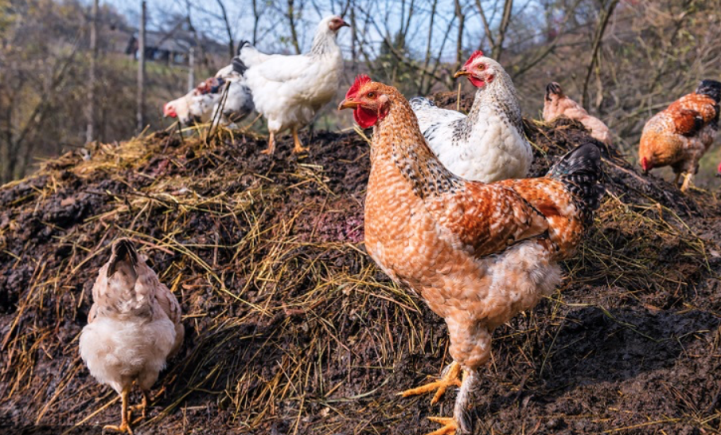
Nitrogen & Pathogen Sources that contribute to stormwater
Can we control them at their source?

Slide 12


Slide 13


Slide 14
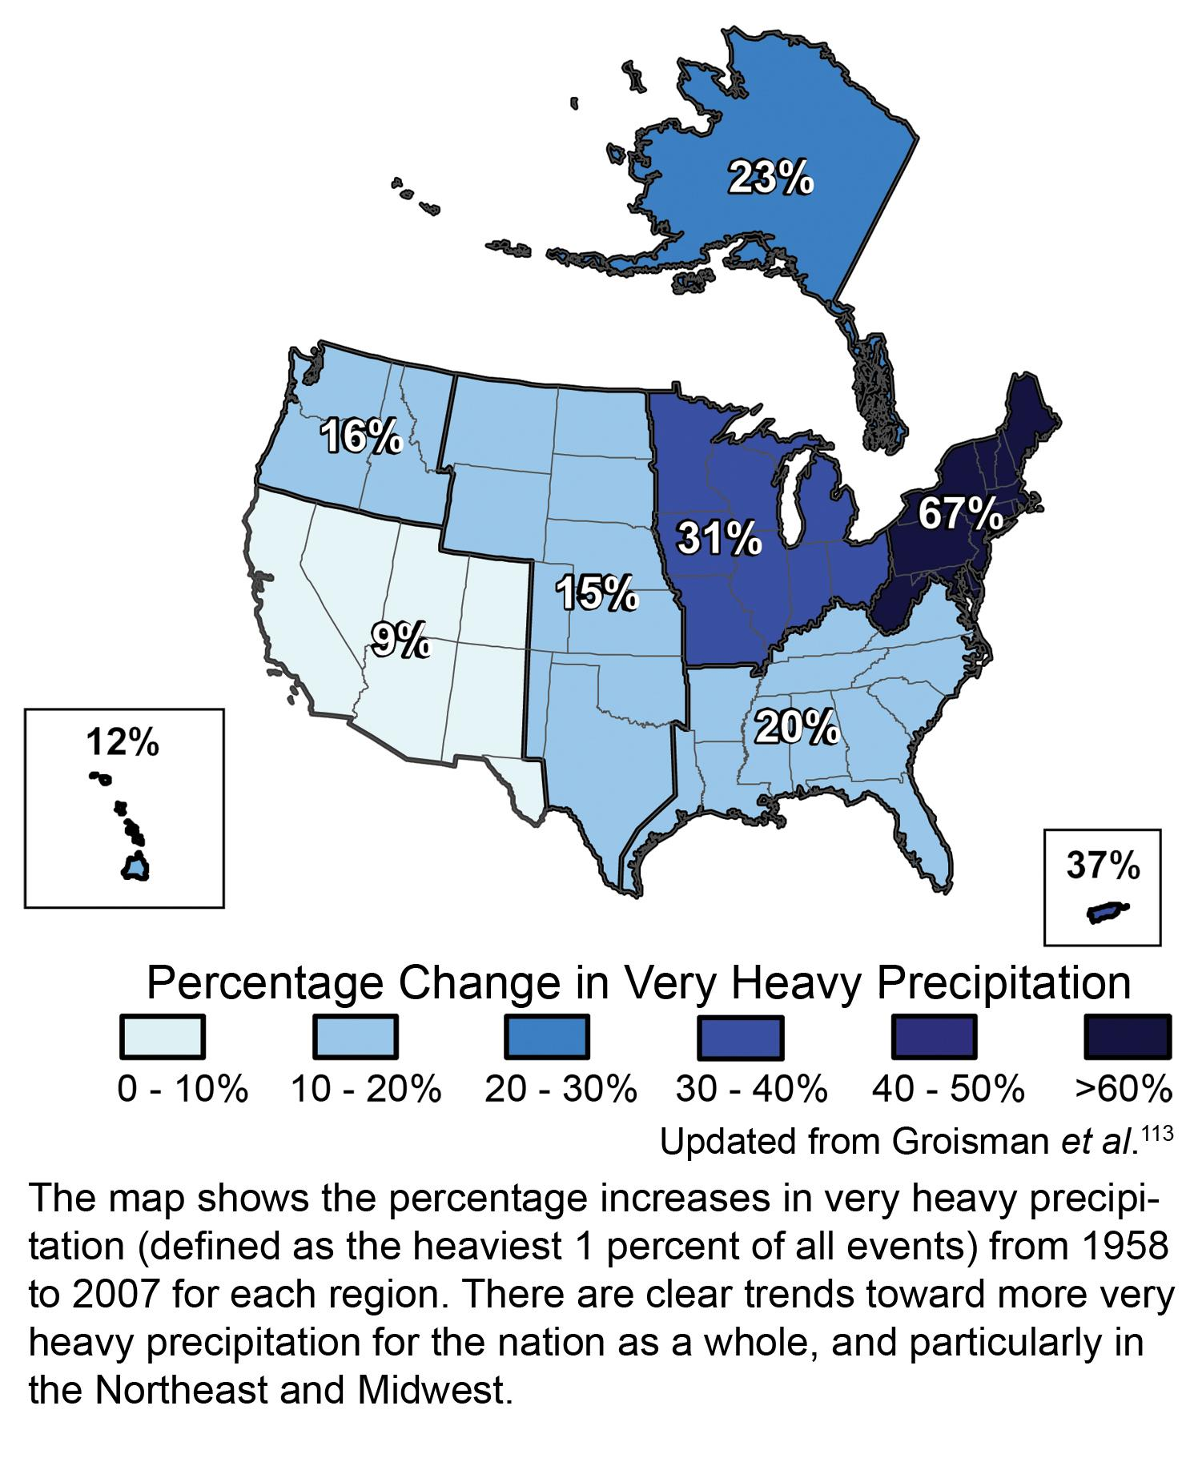
Image credit: U.S. Global Change Research Program (www.globalchange.gov).

Slide 15
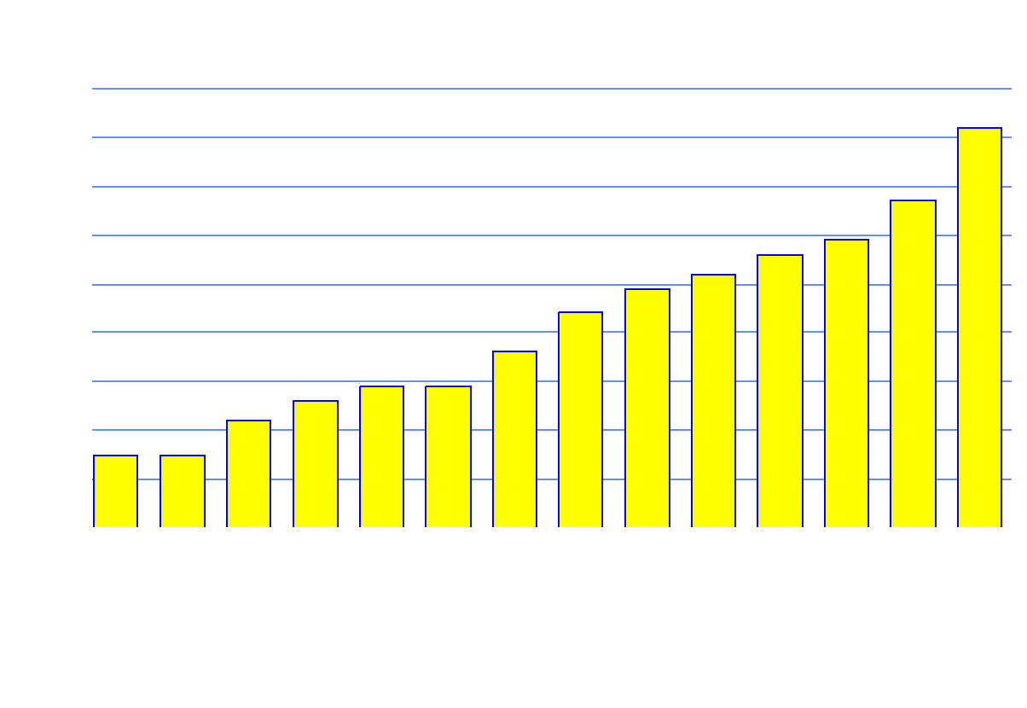
Pollutants in Urban Runoff - Pesticides
82%
67%
56%
59%
Percent Occurrence
52%
49%
44%
36%
26%
29%
29%
22%
15%
15%

Slide 16
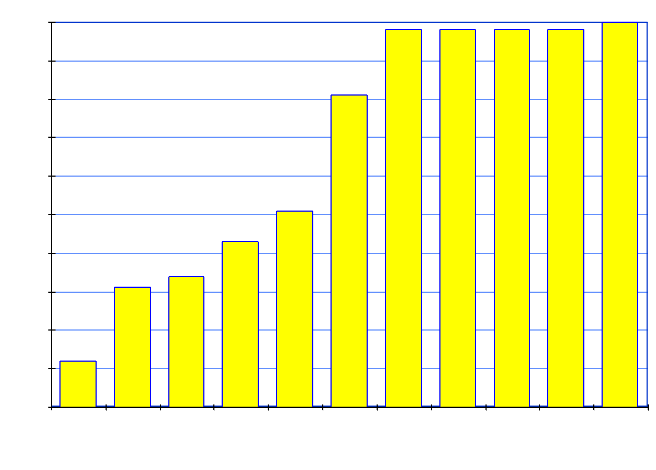
Pollutants in Urban Runoff - Metals & Inorganics
98%
98%
98%
98%
100%
81%
Percent Occurrence
51%
43%
34%
31%
12%

Slide 17
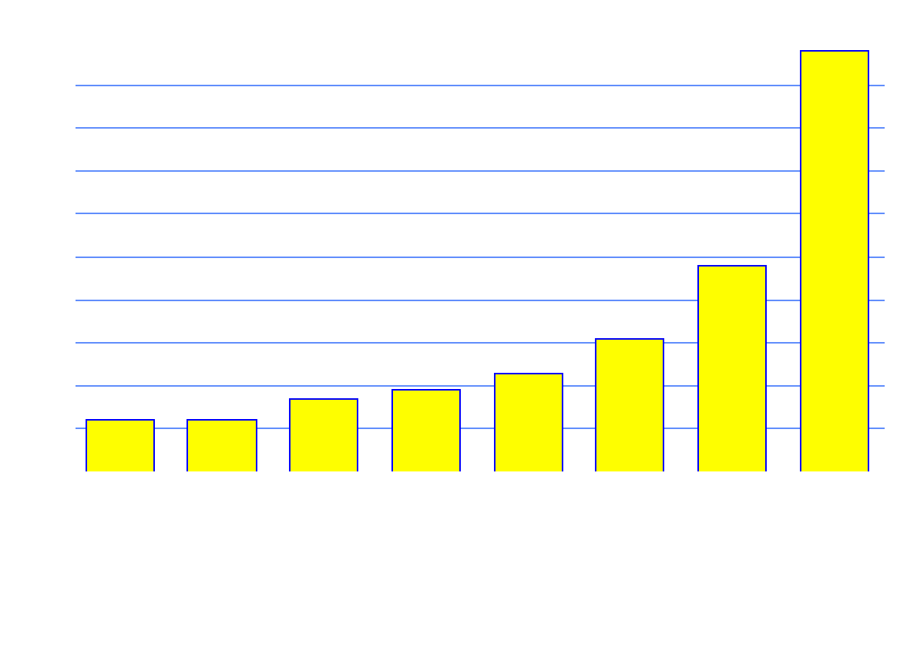
Pollutants in Urban Runoff - PAHs, PCBs & Plasticizer
98%
Percent Occurrence
48%
31%
23%
17%
19%
12%
12%

Slide 18
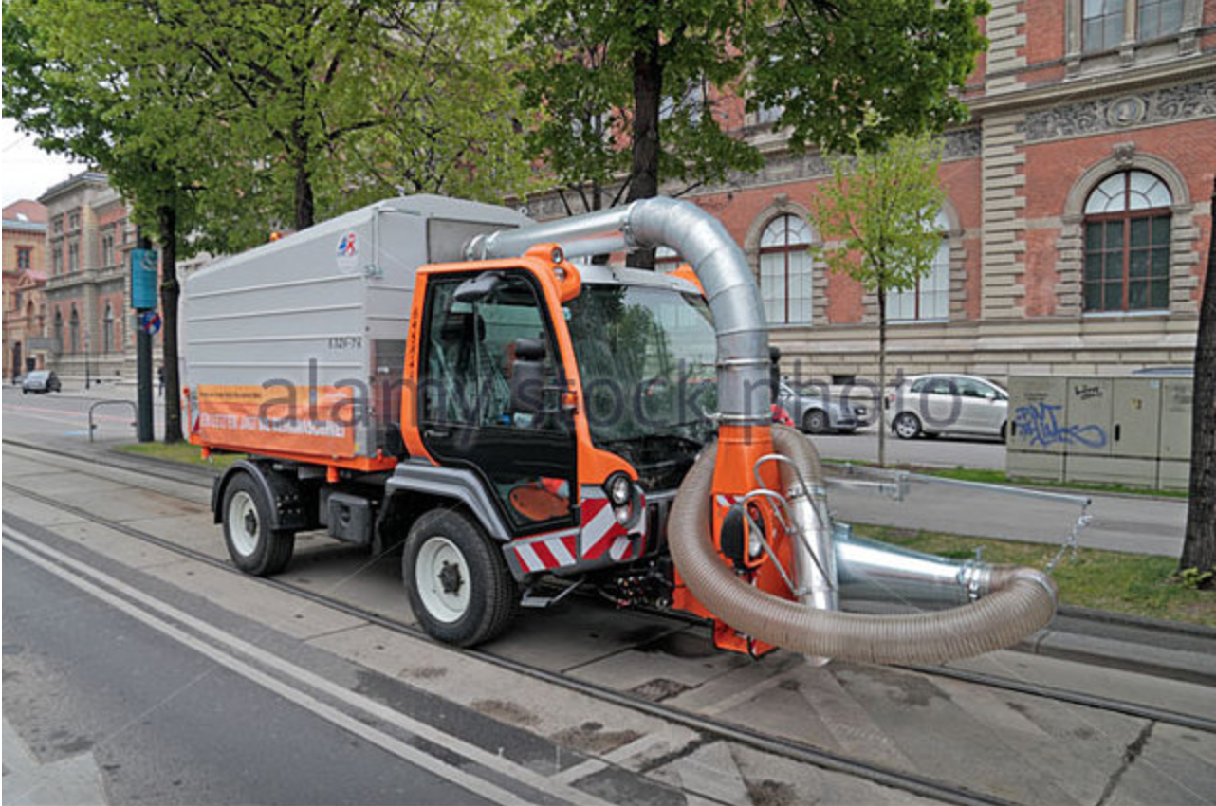
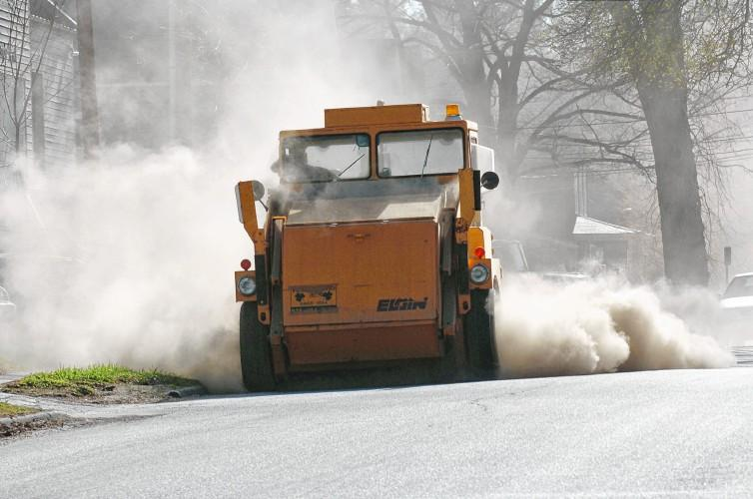

Slide 19
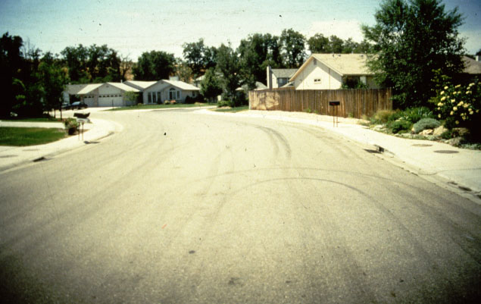
Reduce Impervious Surfaces
Photo Copyright 1999, Center for Watershed Protection
Notes:
Typical streets are often excessively wide, increasing traffic speeds and making streets unfriendly to pedestrians.

Slide 20
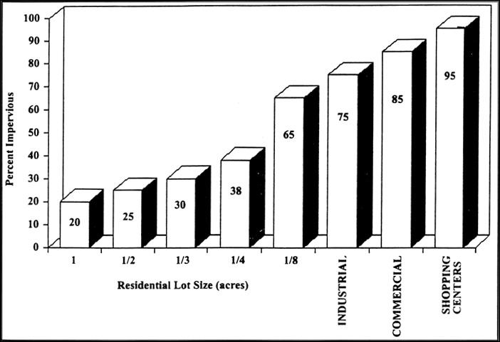
Impervious Area and Types of Development

Slide 21
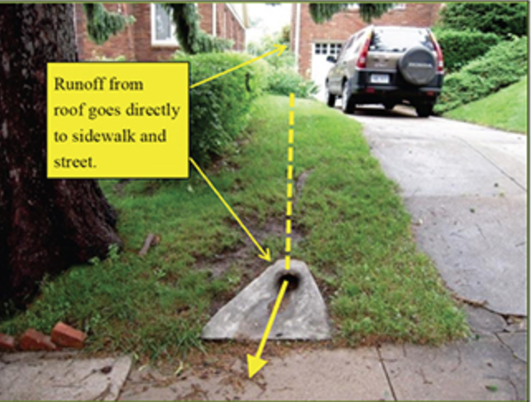
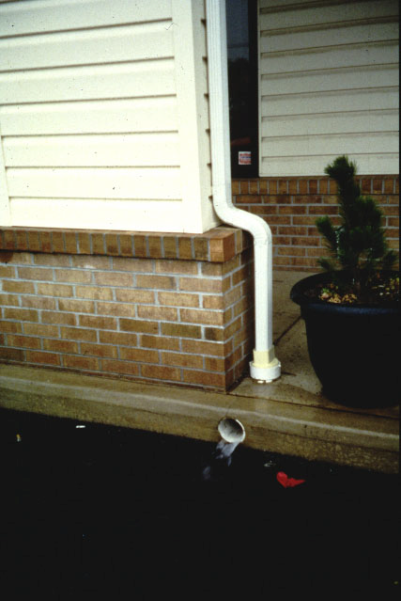
connected impervious surfaces increase volumes and rates of stormwater runoff

Slide 22
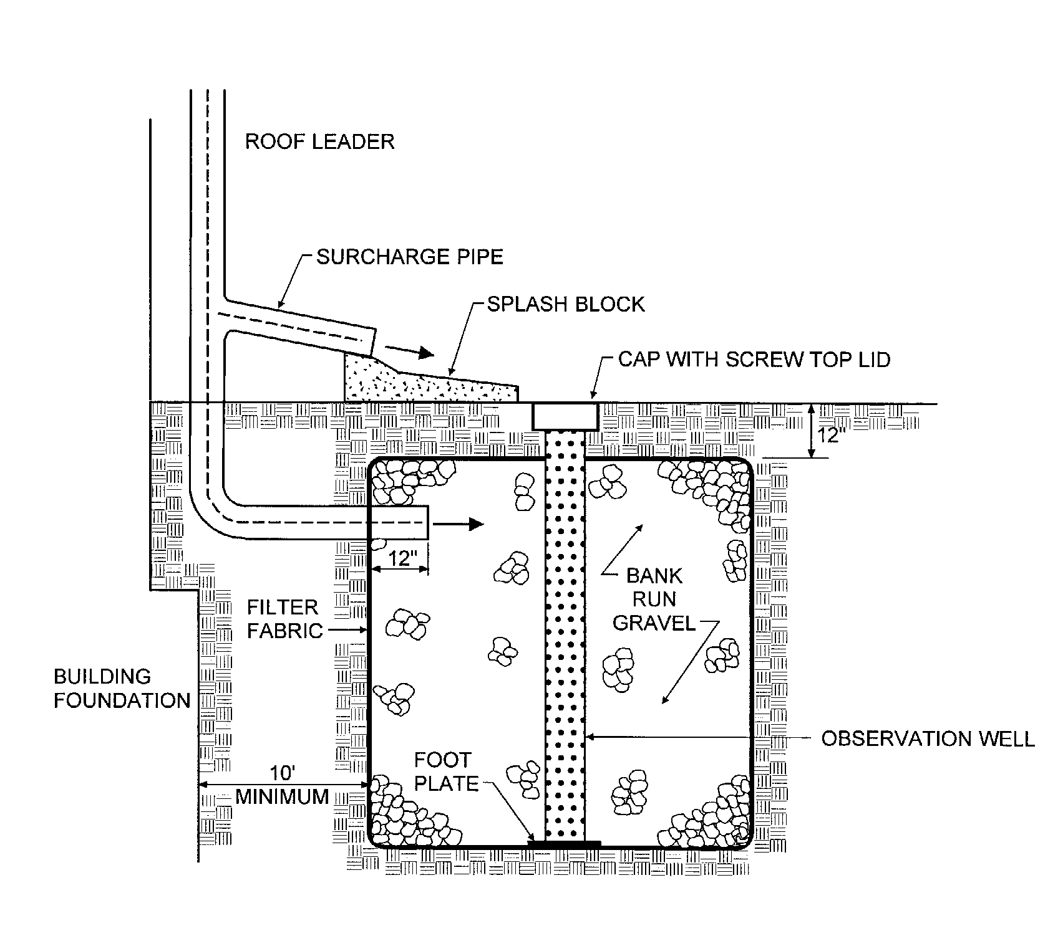
Photo Copyright 1999, Center for Watershed Protection
Notes:
One alternative to managing rooftop runoff is to provide filtration on the lot by using a bioretention area.

Slide 23
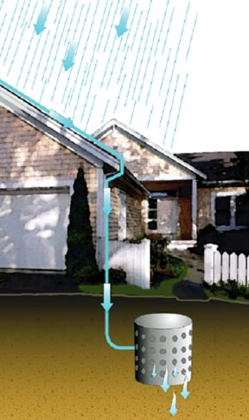
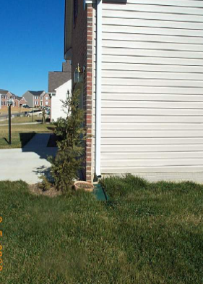
Dry Well Infiltration of Roof Runoff
Source: CWP
Disconnection of Rooftop Runoff to Vegetated Swale
Source: Horsley Witten Group
Notes:
23

Slide 24
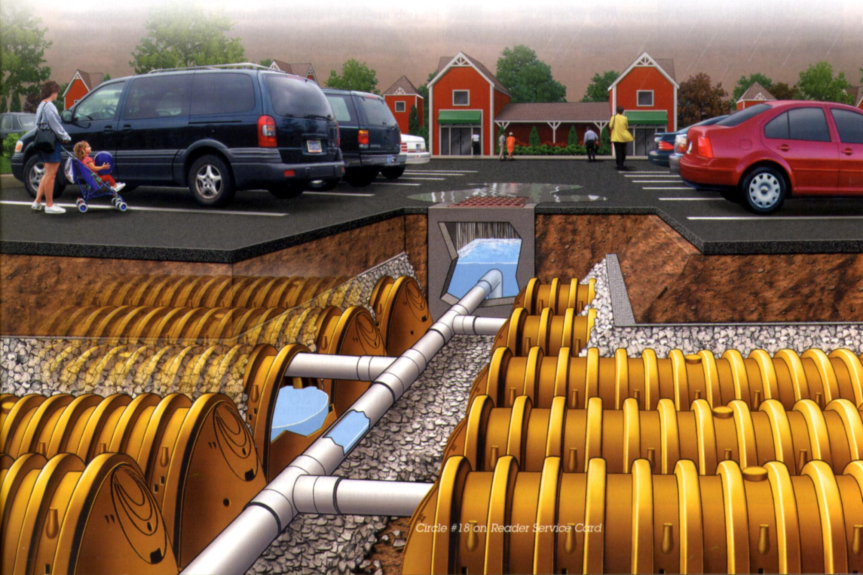

Slide 25
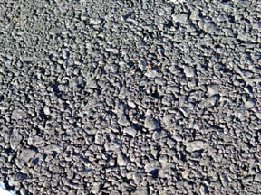
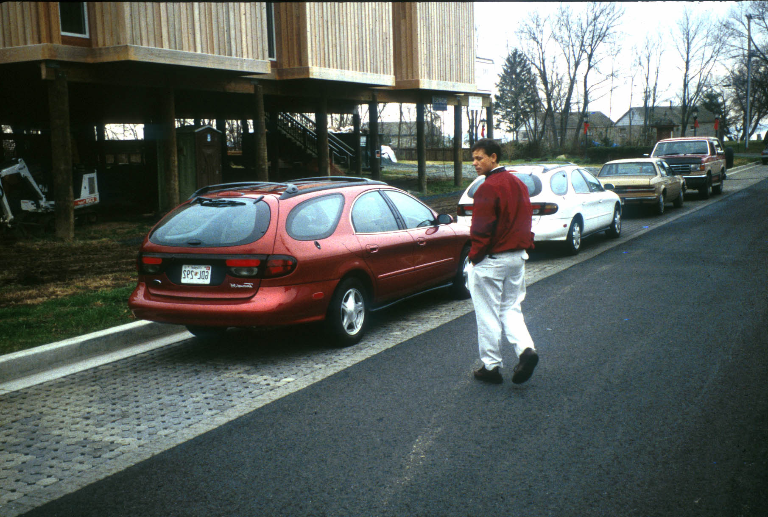
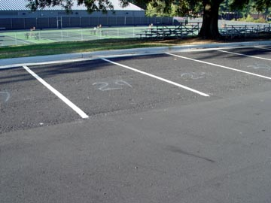
Permeable Pavement
Notes:
25

Slide 26
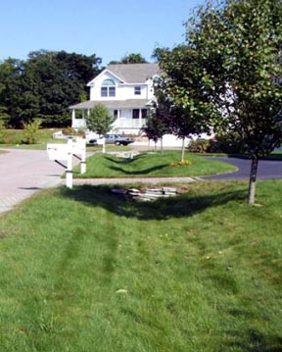
Vegetated Swales
Conveyance, Treatment, Infiltration
Roadside swales (“country drainage”) for lower density and small-scale projects
For small parking lots
Mild side slopes and flat longitudinal slopes
Provides area for snow storage & snowmelt treatment
Notes:
26

Slide 27
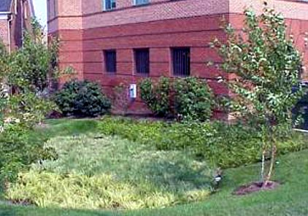
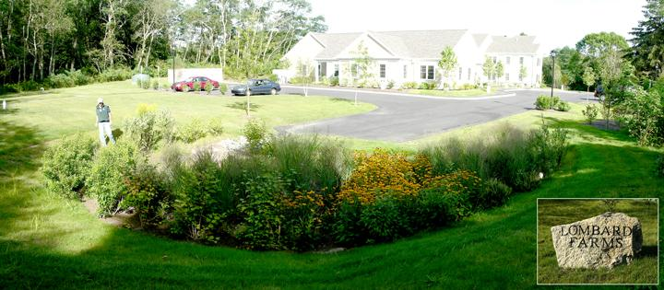
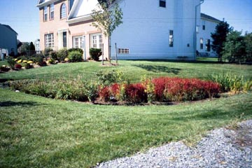
Bioretention Applications
Parking lot islands
Median strips
Residential lots
Office parks
Source: Larry Gavin
Source: LID Center
Notes:
27

Slide 28
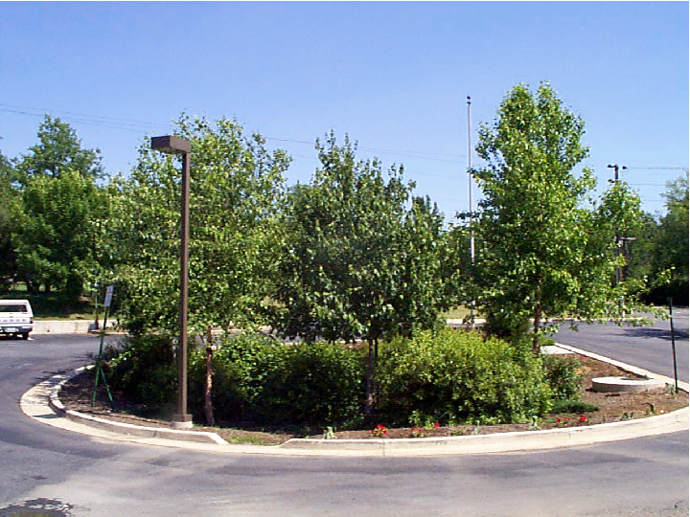

Slide 29
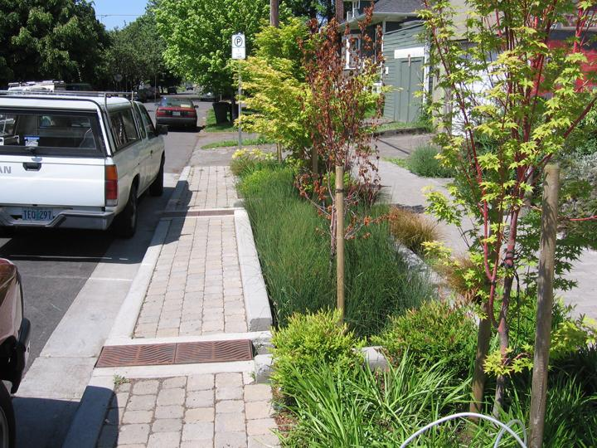

Slide 30
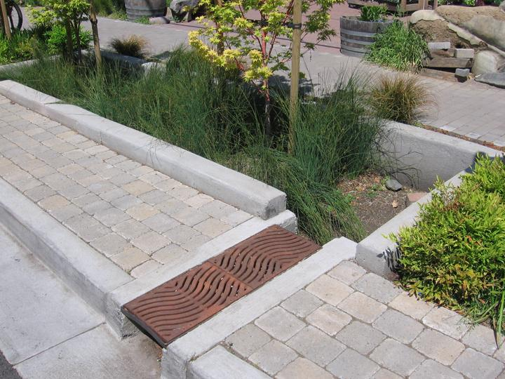

Slide 31
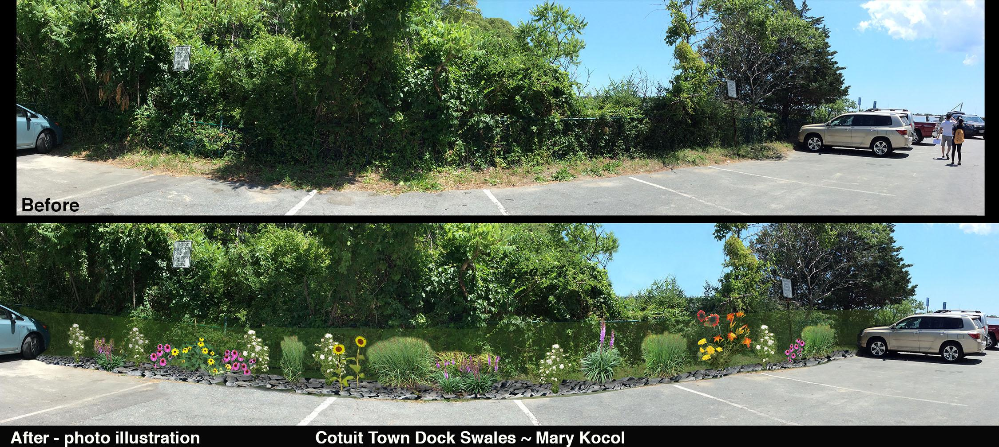
Case Study: Bioretention - Cotuit Town Dock

Slide 32
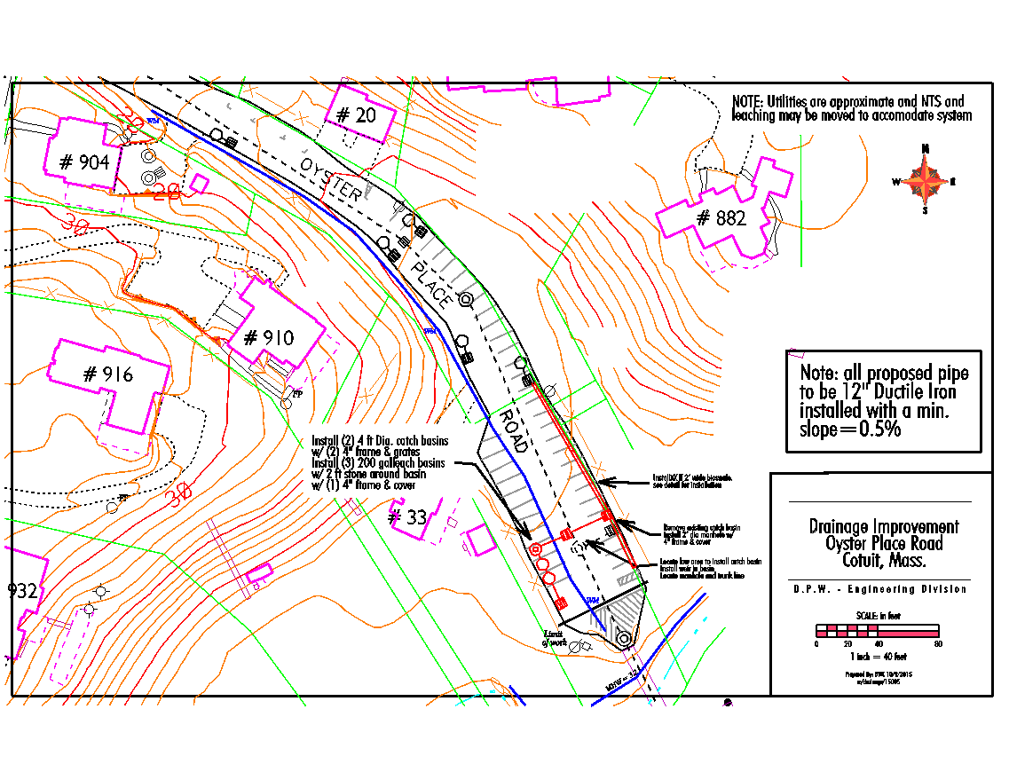

Slide 33
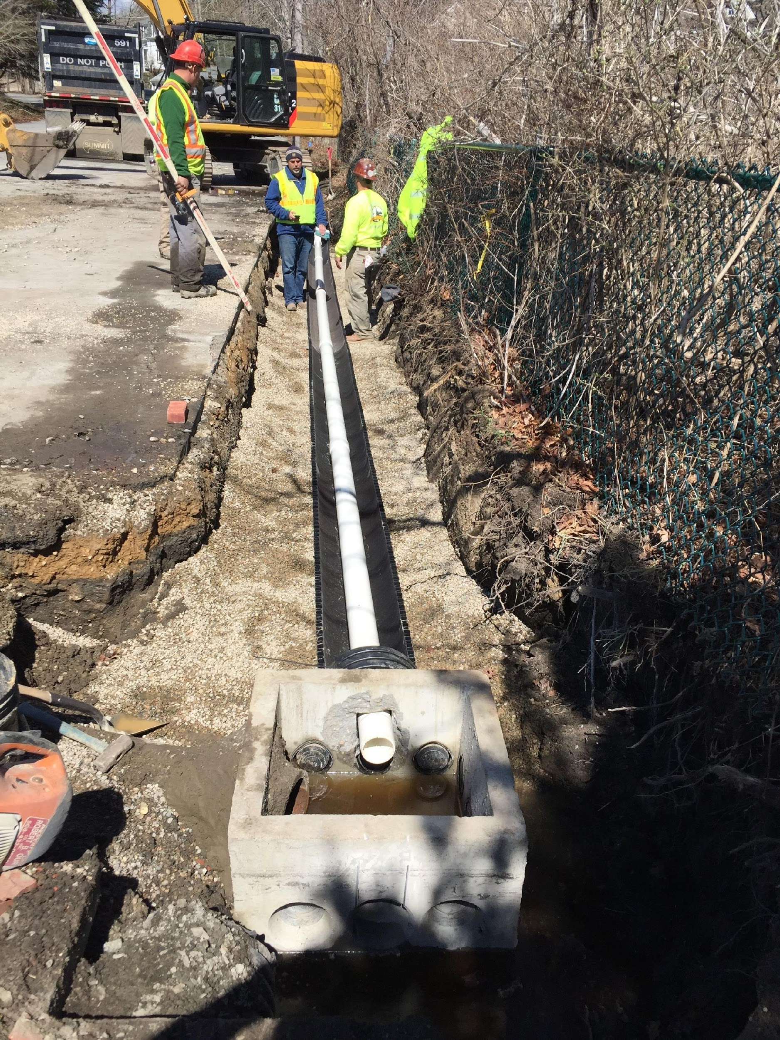

Slide 34
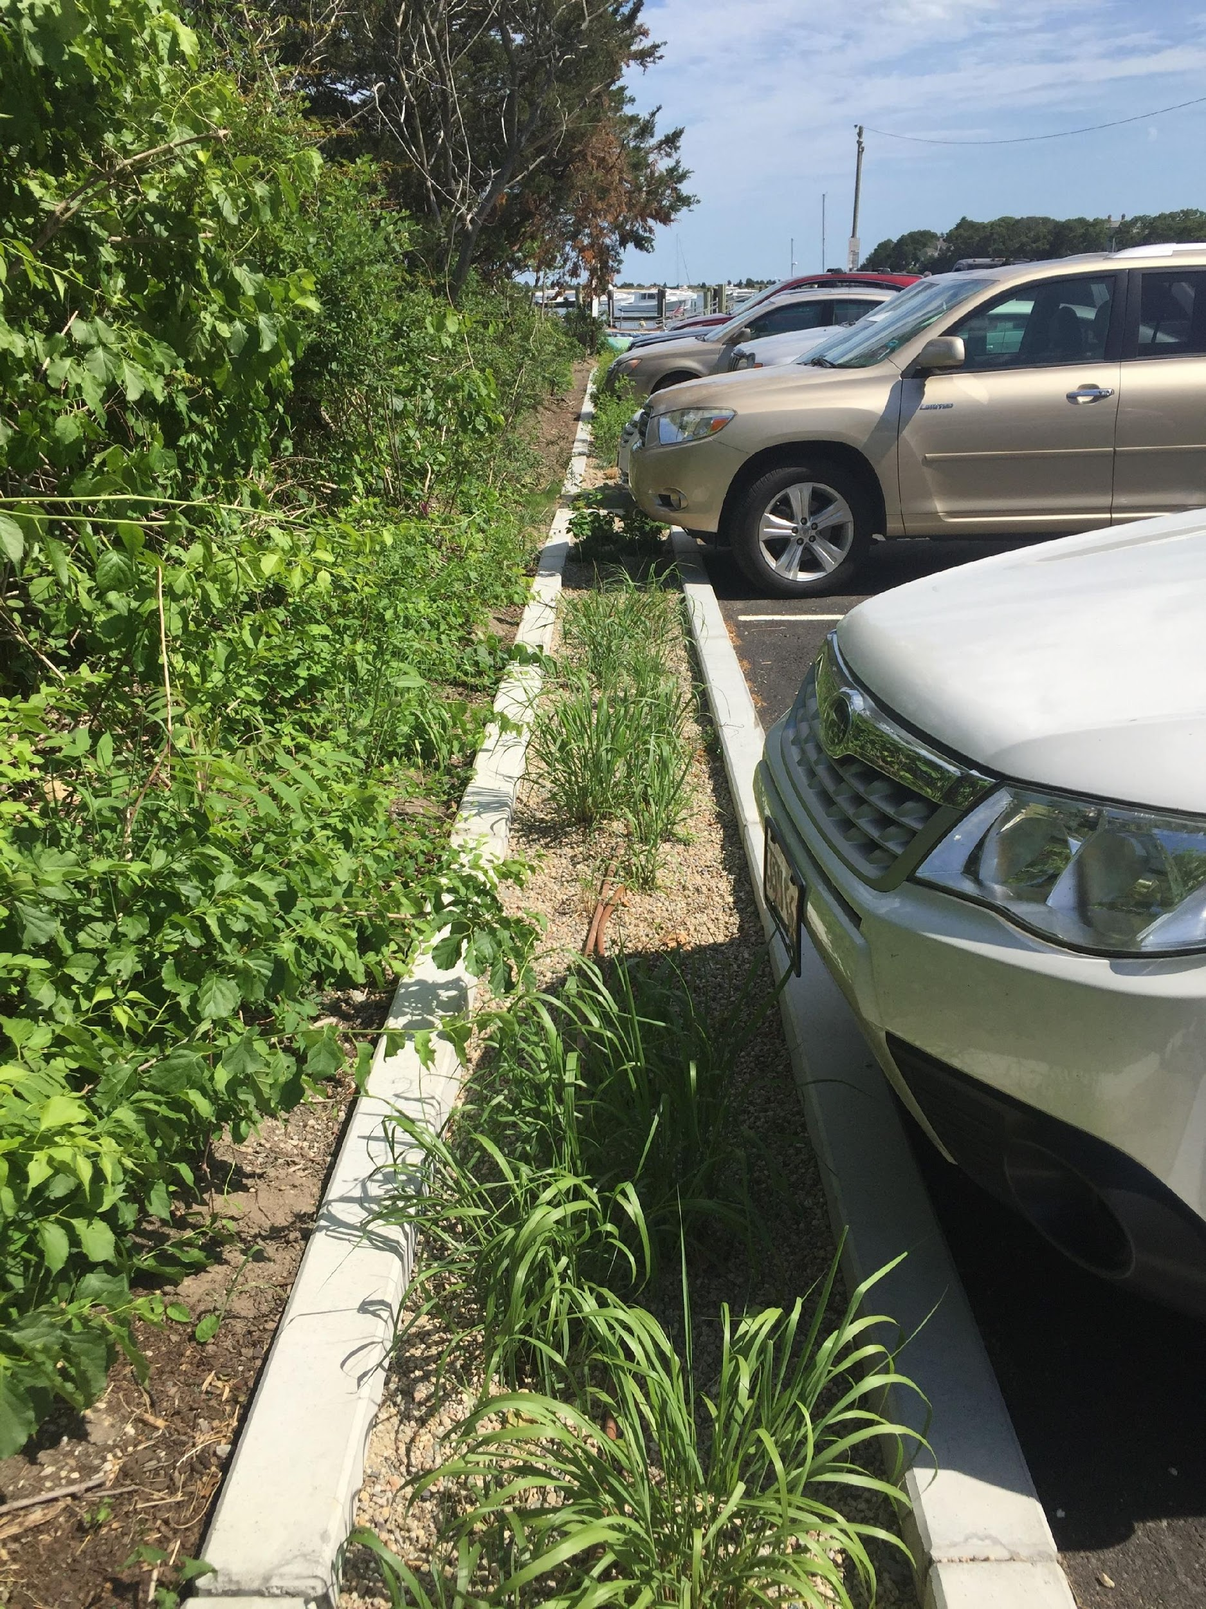

Slide 35
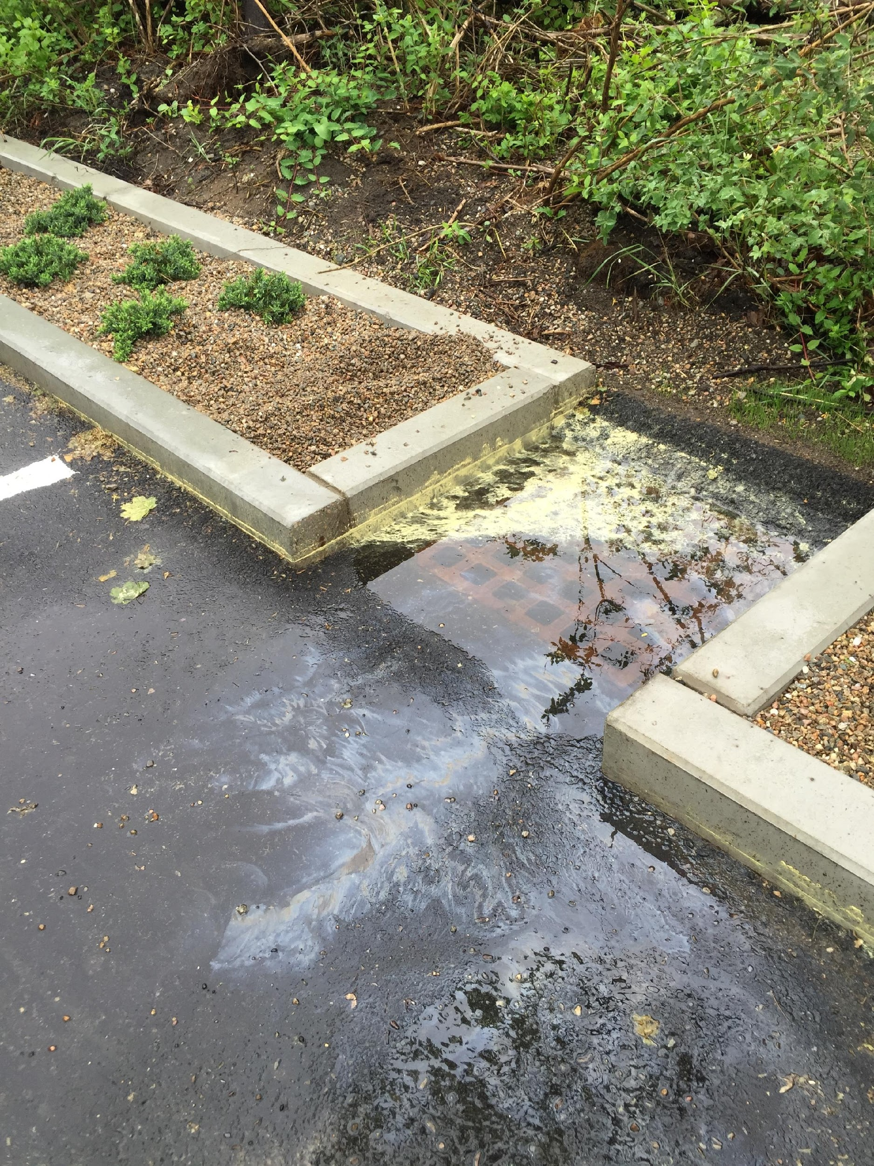

Slide 36
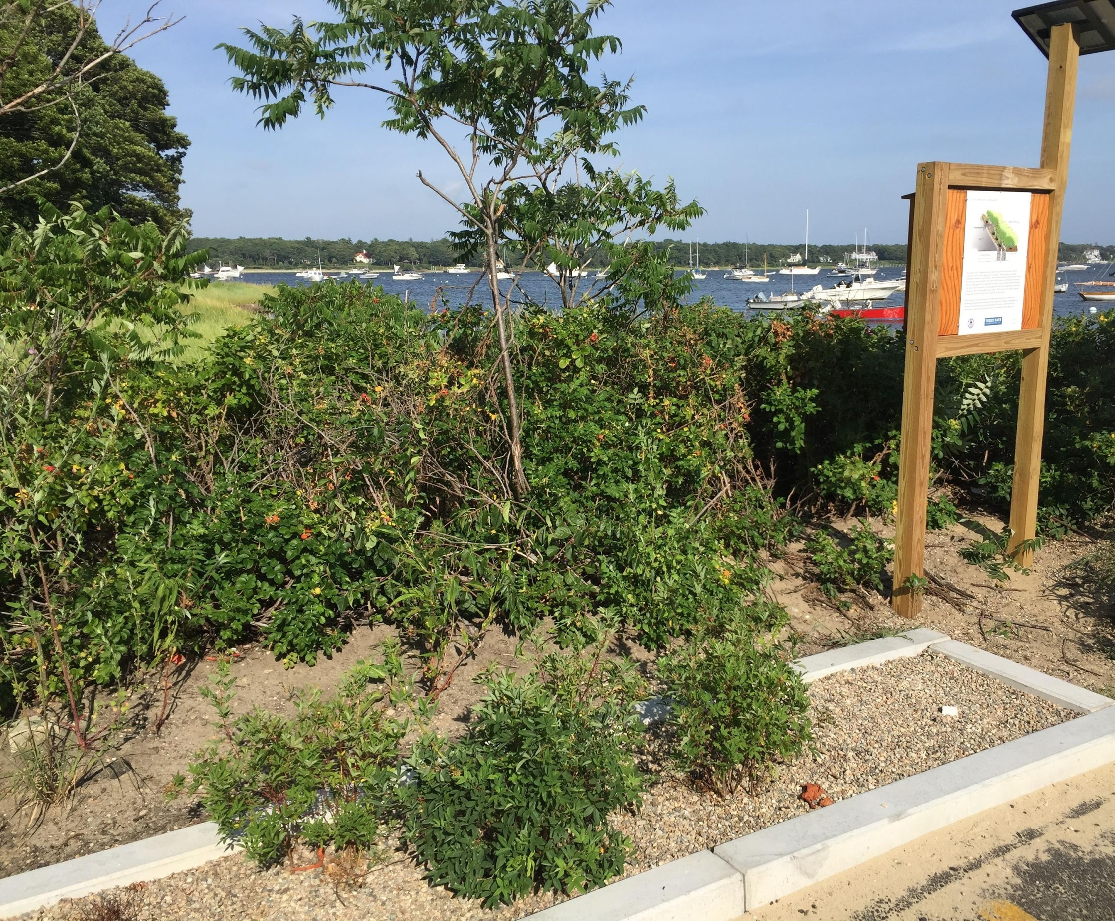

Slide 37
solar panel connected to water pump in well
Captures groundwater with nitrogen and pumps to bioretention cell for treatment during sunny days
Fertigation Well

Slide 38
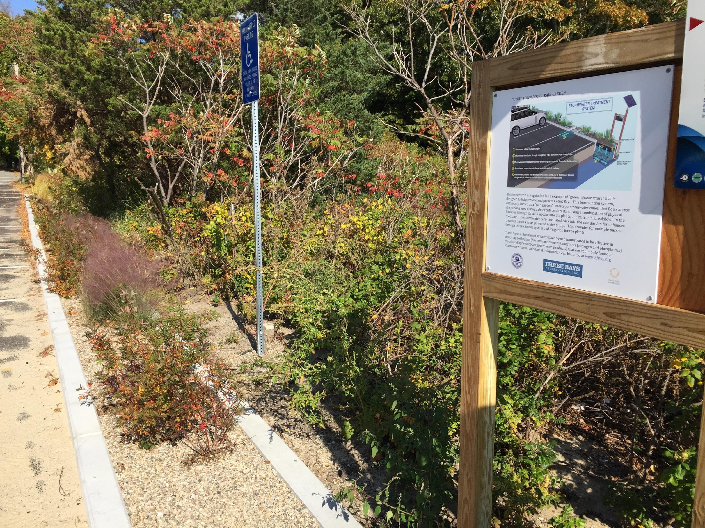

Slide 39
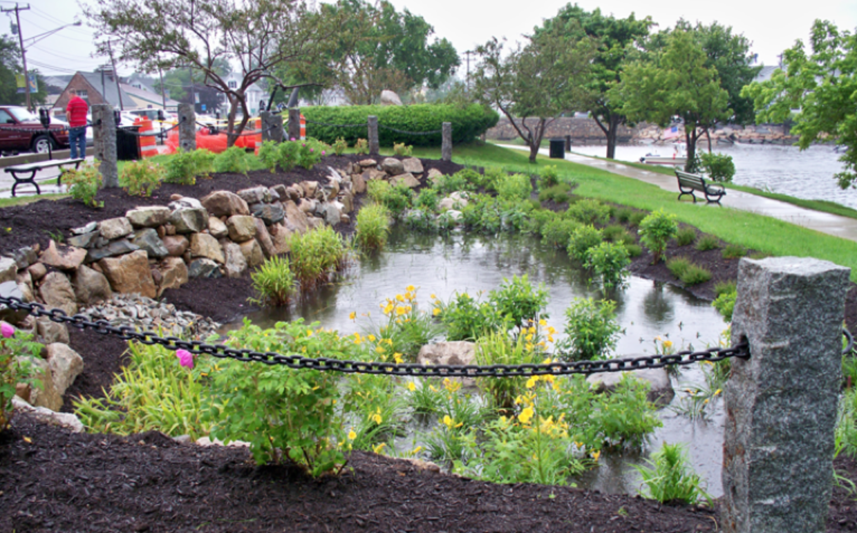
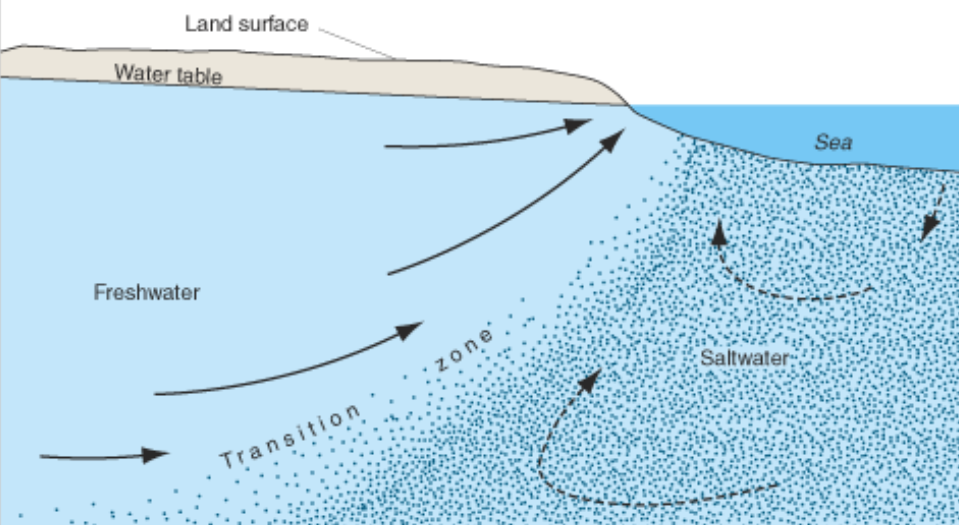

Pumped PRB conceptual/wellfleet
Stormwater Wetland
pump & treat
N-enriched groundwater between storm events
Well
Groundwater

Slide 40
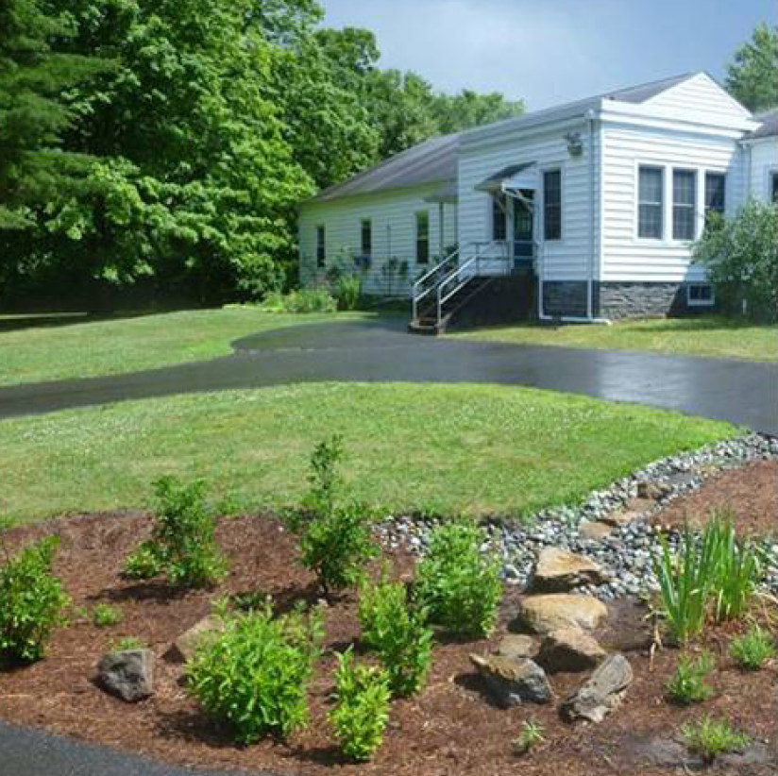
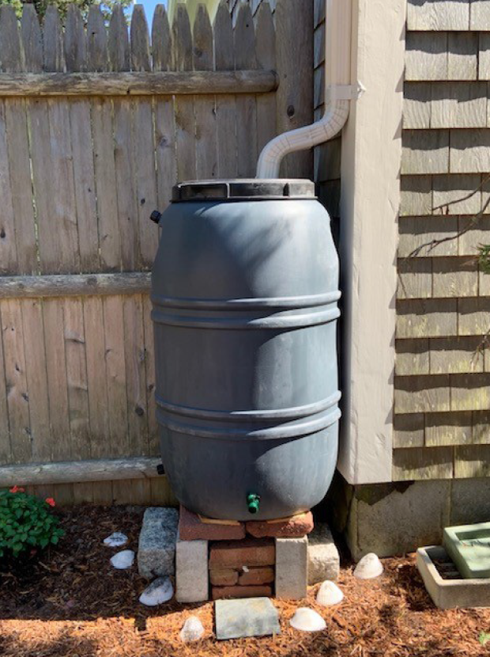
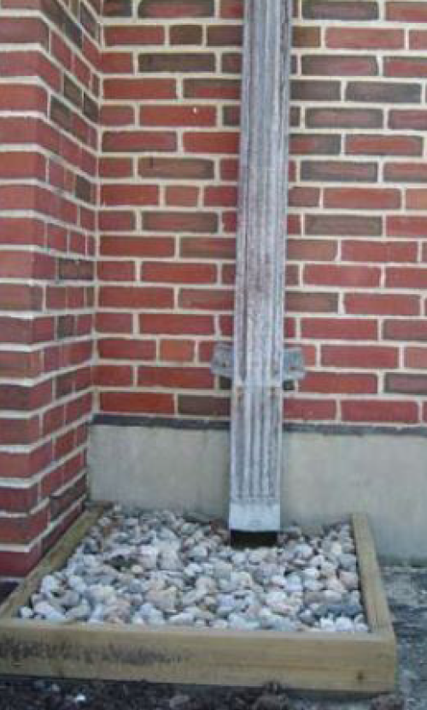
Stormwater Practices for Smaller Projects (Residential)
Infiltration of Roof Runoff
Rain Garden
Rain Barrel – Use for Irrigation

Slide 41
Stormwater Practices for Larger Projects (Businesses, Roads)
Infiltration (Subsurface Chambers)
Vegetated Practices
(Bioretention, Constructed Wetlands)

Slide 42

Mill Pond Road
Country Drainage

Slide 43



Slide 44



